Slide 1
Boston Crime: Districts Crime Analysis and Visualization
Yu Sun, Liyu Qiang

Slide 2
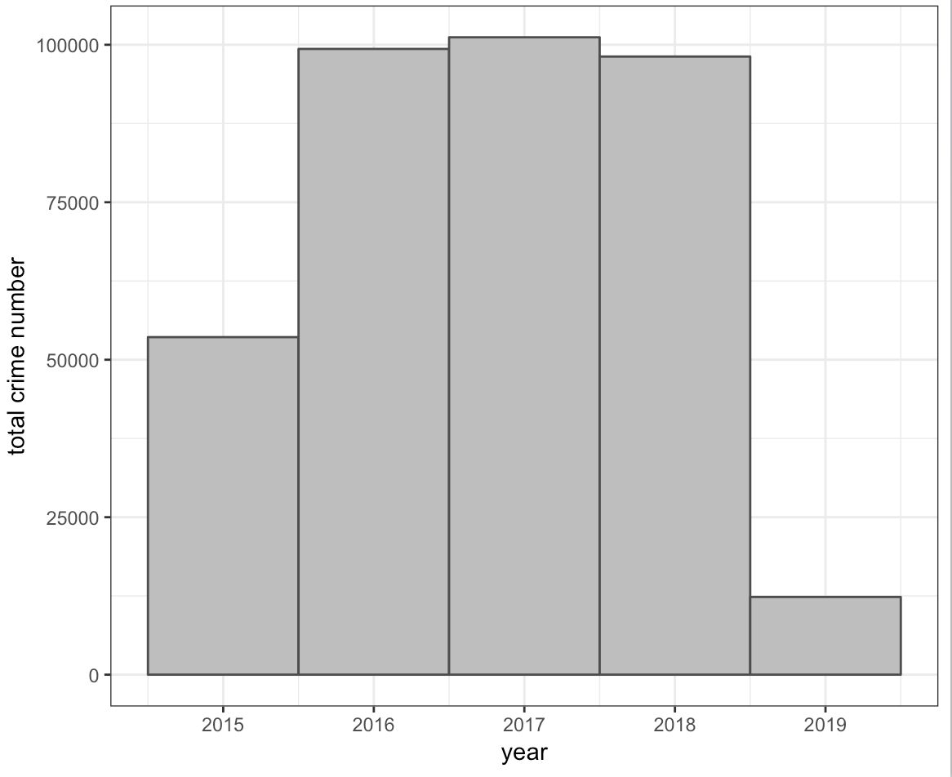
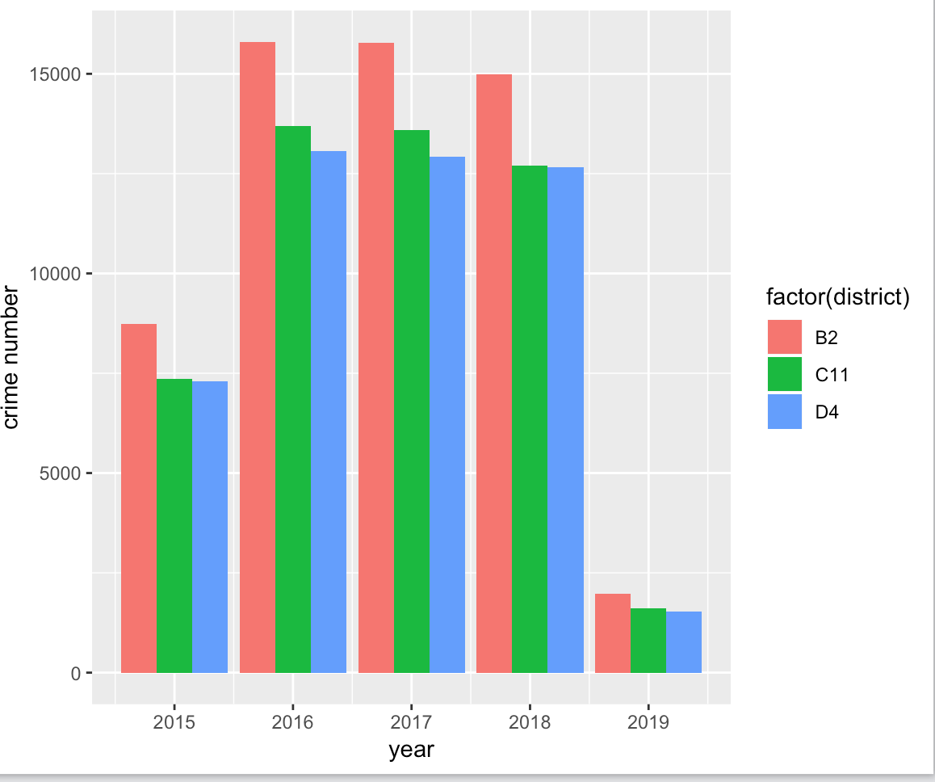
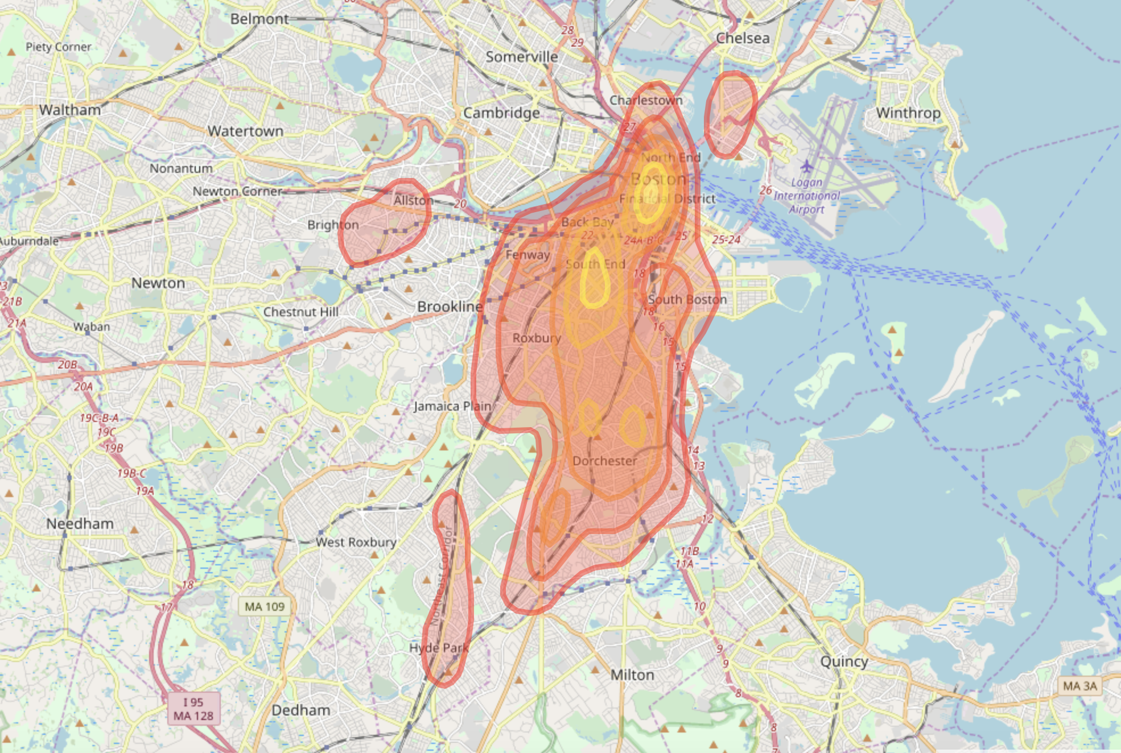
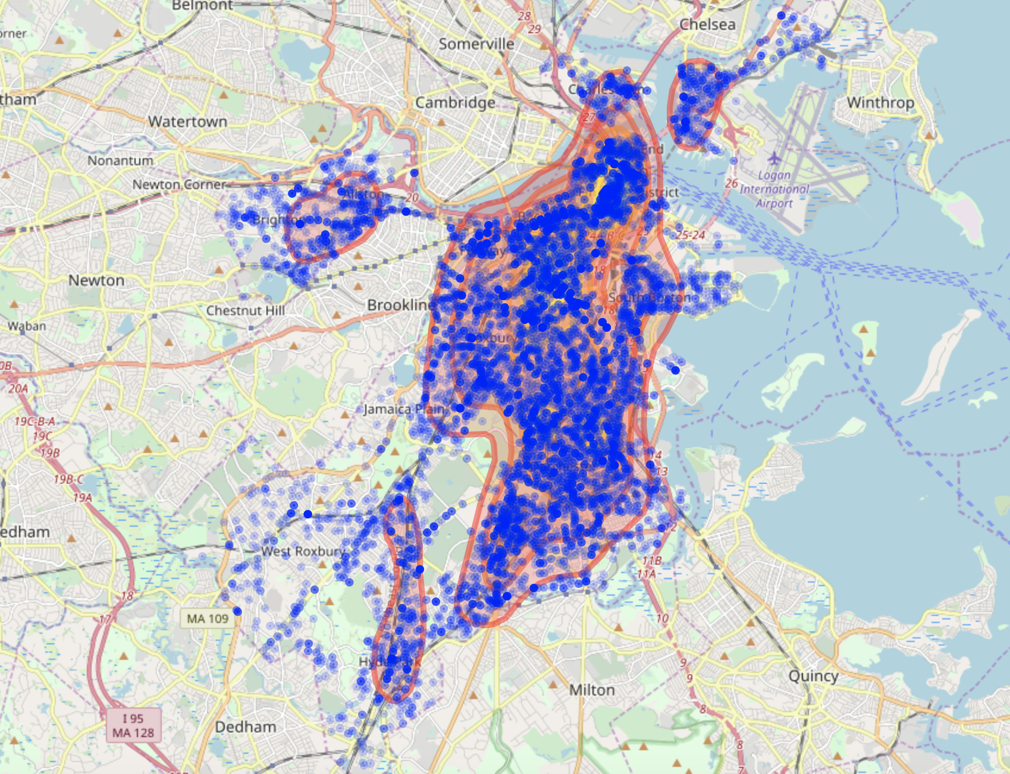
Boston Crime Distribution and Top3 Dangerous District
Crime number for 2016-2018 almost same
Crime data for 2015 and 2019 is not completed
For each year, B2,C11 and D4 are most dangerous 3 district
Frome map, we can estimate top 3 dangerous districts are the area highlighted in yellow.
Next, we decide to analysis when crimes happen more often and which kind of crimes happen most

Slide 3
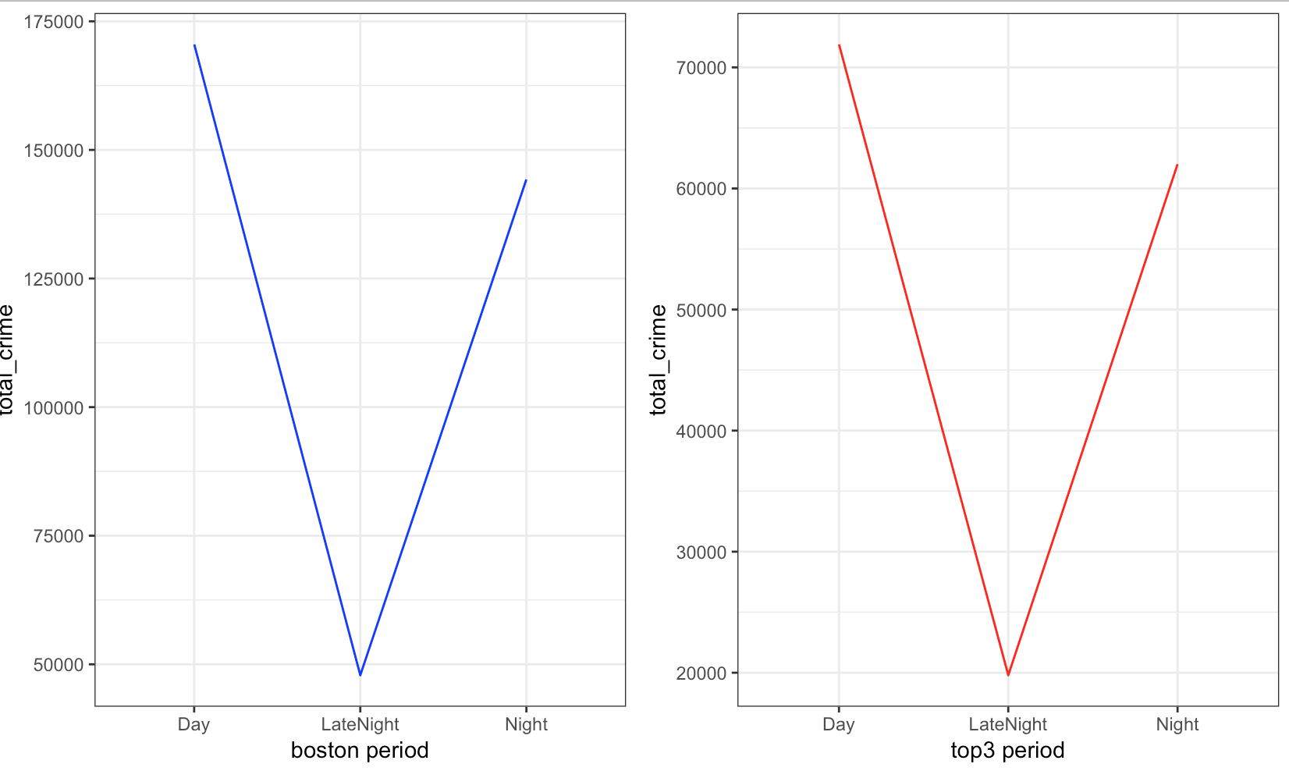
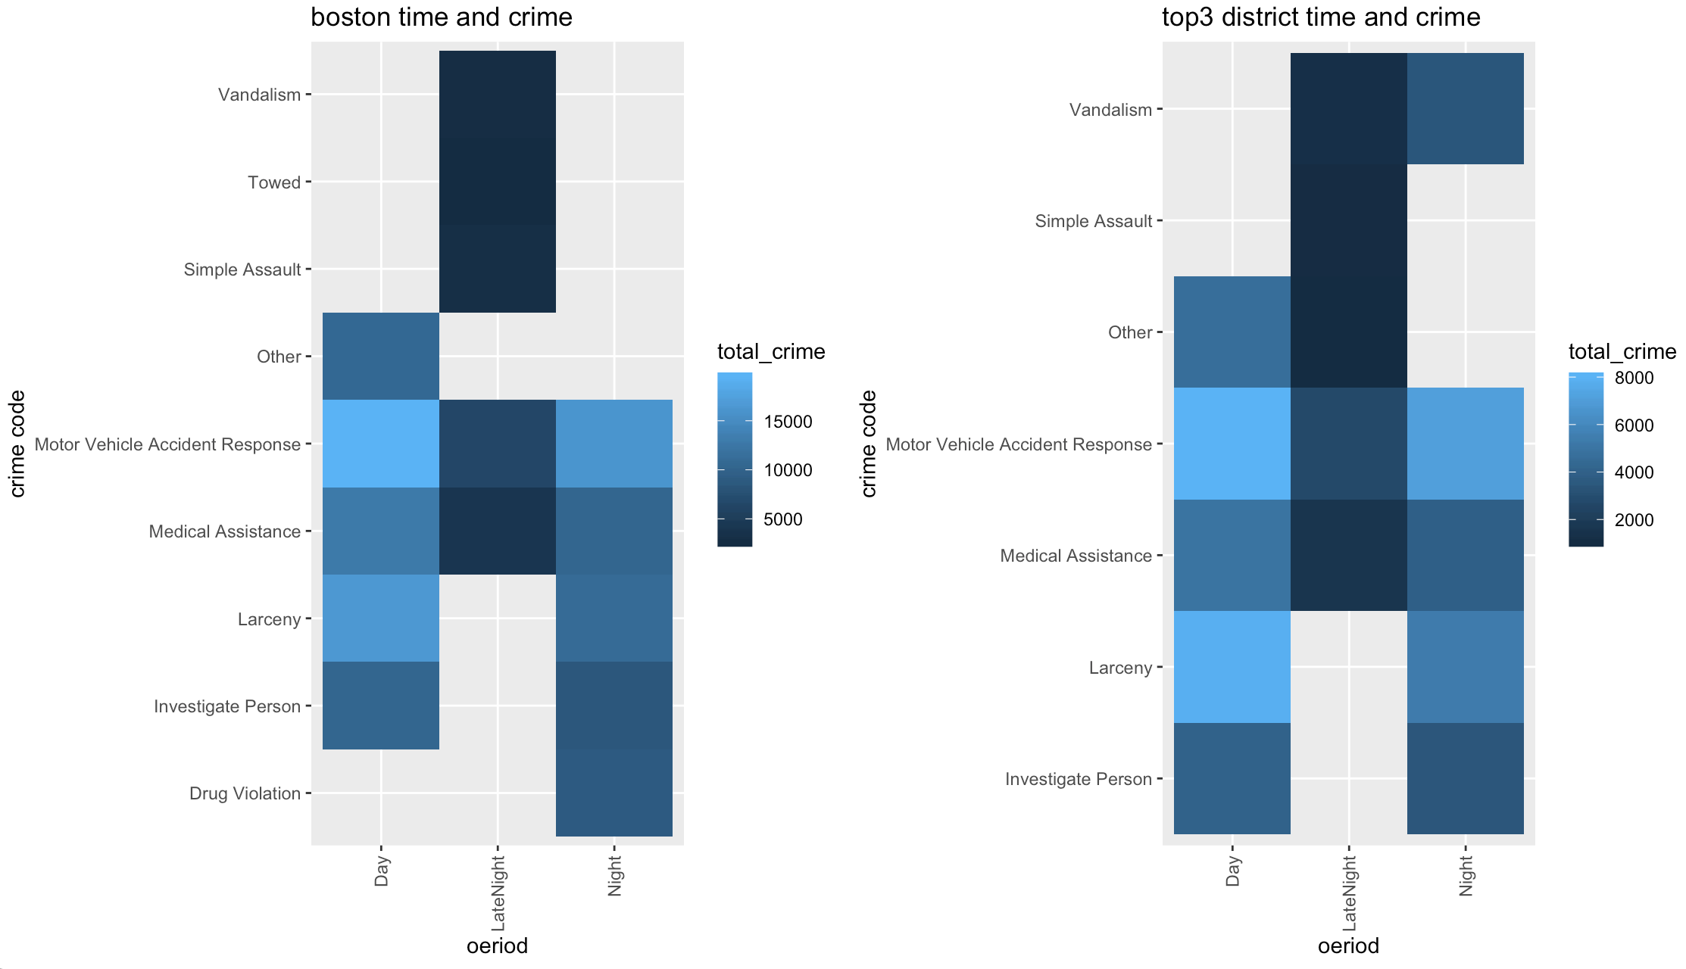
Crime Happening Time and Category Analysis
Seperate hour to three 6-hour periods and find the crime number distribution of boston and top 3 dangerous districts among periods are almost exactly same.
Vehicle Accident Response and Medical Assistance both are in Top 5 most happening crimes in each period for boston and Top 3 dangerous district
We still can see the top 5 most happening crimes in 3 most dangerous district are different from Boston during each period. In top 3 dangerous district, the assault crimes are more common during night and late night.

